Slide 1
Lane Detection using Convolutional Neural Network

Slide 2
Why Lane detection is important?
Lane detection has a great influence in the field of automatic driving and is an important basis for vehicle path planning and path decision making.
Lane Departure Warning System (LDWS) is one of the most important aspects of Intelligent Vehicle (IV) technology, which is an active safety system to prevent unintended lane departure that can lead single vehicle roadway departure, lane change/merge, and rollover crashes.

Slide 3
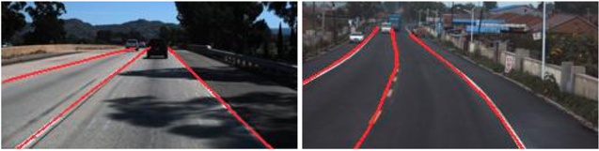
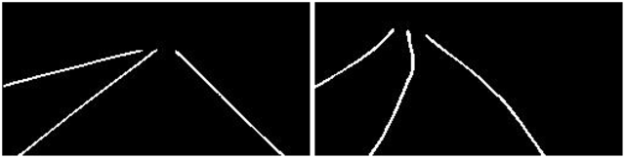
Output of a Convolutional neural network model:
Figure 1:Final output of CNN model
Figure 2:Ground truth for CNN model

Slide 4
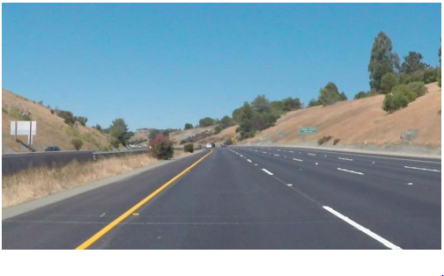
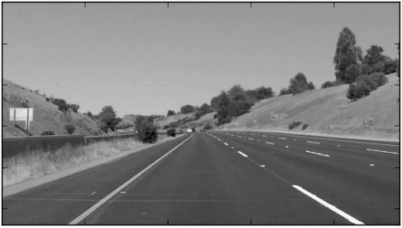
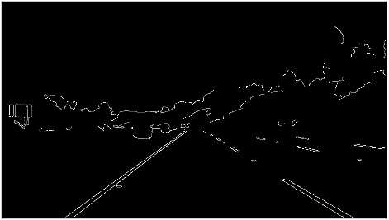
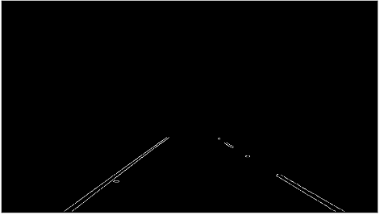
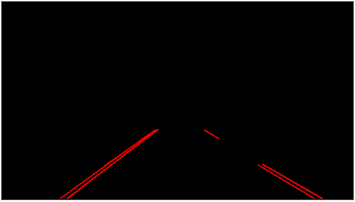
Typical steps to perform lane detection using image processing:
Step 0: Introduction
Step 1: Pre-processing of image
Step 2: Canny Edge Detection
Step 3: Mask out points that are not in the region of interest
Step 4: Hough Transform

Slide 5
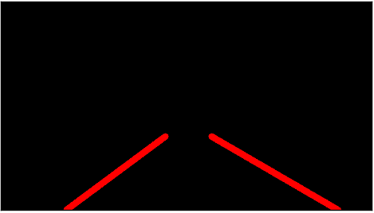
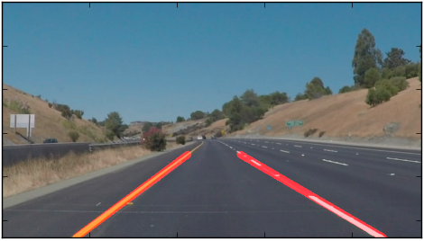
Step 5: Extrapolate the individual, small lines and construct the left and right lane lines
Step 6: Add the extrapolated lines to the input image

Slide 6
Problem with Lane detection
Diverse lane pattern such as solid,broken,splitting and merging lane make independent lane modelling difficult.
Inconsistent number of lane.
Not always bounded by lines(curbs and guard rails).
Covered lane markings due to shadows of trees,bridges or other cars on the road etc.
Interference from other signs in urban roads.
Lighting changes

Slide 7
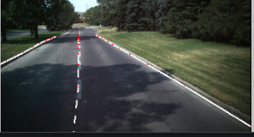

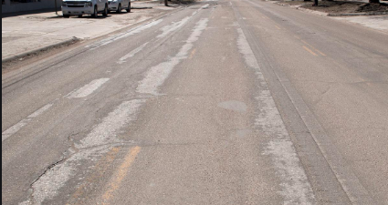

Shadow lane
Bright lane
Lane with other signs in urban roads lane
faded lane
Figure 3:Various example for lane detection problems

Slide 8
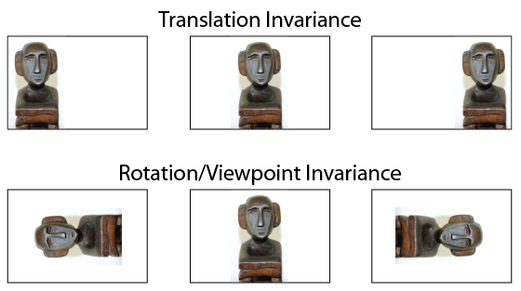
Why Convolutional Neural network work better for image then Multi layer perceptron
It provide location Invariance, Invariance means that you can recognize an object as an object, even when its appearance varies in some way.
Figure 4:Translation and Rotation in-variance
In terms of performance, CNNs outperform NNs on conventional image recognition tasks and many other tasks. Look at the Inception model, Resnet50 and many others for instance.

Slide 9
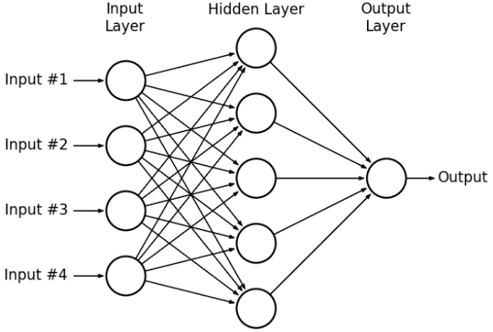
Figure 5:Single hidden layer multi-layer perceptron
Another main feature of CNNs is weight sharing:
For one layered CNN with 10 filters of size 5x5. Now you can simply calculate parameters of such a CNN:
Total parameter= 5*5*10 weights and 10 biases i.e 5* 5*10 + 10 = 260 parameters.
For one layered NN with 250 neurons, here the number of weight parameters depending on the size of images is ‘250 x K’ where size of the image is P X M and K = (P *M). Additionally, you need ‘M’ biases. For the MNIST data as input to such a NN we will have:
Total Parameter= 250*784+1 = 19601 parameters.
Clearly, CNN is more efficient in terms of memory and complexity.

Slide 10
Convolutional Neural network Layers
Convolution Layer
Pooling Layer
Activation Layer
Dropout Layer

Slide 11
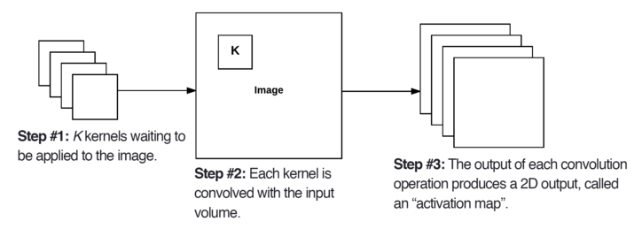
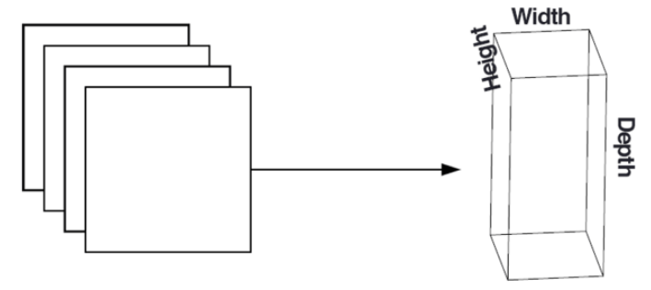
Convolution layer
Figure 6:Convolution operation with K kernel
Figure 7:After obtaining the K activation maps, they are stacked together to form the input volume to the next layer in the network.

Slide 12
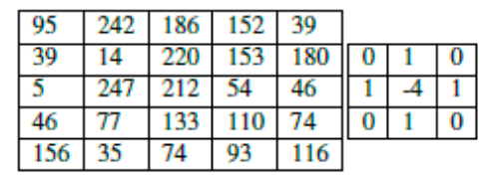
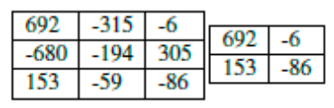
Component of Convolution Layer:
1) Stride:
Table 1:Our input 5×5 image (left) that we are going to convolve with a Laplacian kernel (right).
Table 2: Left: Output of convolution with 1×1 stride. Right: Output of convolution with 2×2 stride. Notice how a larger stride can reduce the spatial dimensions of the input.

Slide 13
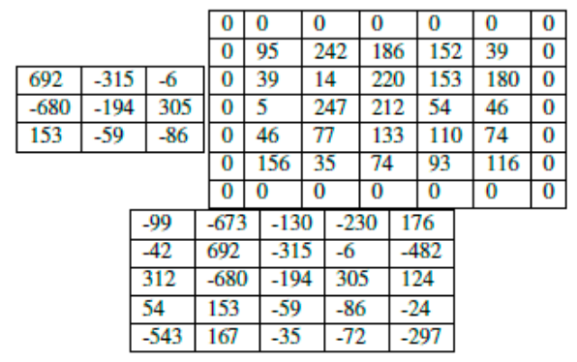
2)Zero-padding:
Table 3: Left: The output of applying a 3×3 convolution to a 5×5 input (i.e., the spatial dimensions decrease). Right: Applying zero-padding to the original input with P = 1 increases the spatial dimensions to 7×7. Bottom: After applying the 3×3 convolution to the padded input, our output volume matches the original input volume size of 5×5, thus zero padding helps us preserve spatial dimensions.

Slide 14
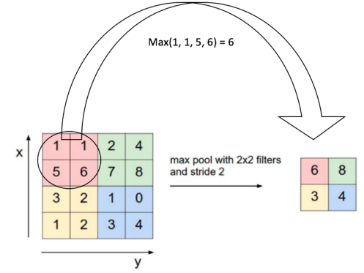
The Pooling layer
Spatial Pooling (also called sub-sampling or down-sampling) reduces the dimensionality of each feature map but retains the most important information.
We slide our 2 x 2 window by 2 cells (also called ‘stride’) and take the maximum value in each region, this reduces the dimensionality of our feature map as shown in figure 3.
Figure 8: Max Pooling Operation

Slide 15
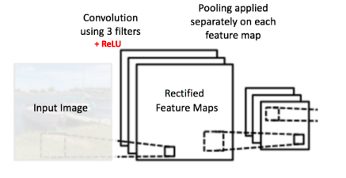
pooling operation is applied separately to each feature map (notice that, due to this, we get three output maps from three input maps) as shown in figure 4.
Figure 9:Max pooling on each feature map

Slide 16
Function of Pooling Layer:
The function of Pooling is to progressively reduce the spatial size of the input representation In particular, pooling makes the input representations (feature dimension) smaller and more manageable.
Reduces the number of parameters and computations in the network, therefore, controlling over-fitting.
Makes the network invariant to small transformations, distortions and translations in the input image (a small distortion in input will not change the output of Pooling – since we take the maximum / average value in a local neighborhood).
Helps us arrive at an almost scale invariant representation of our image (the exact term is “equivariant”). This is very powerful since we can detect objects in an image no matter where they are located.

Slide 17
Activation function
Some of the Non-Linear Neural Networks Activation Functions:
1) Sigmoid / Logistic Activation Function
2) Tanh Function
3) ReLU Function

Slide 18
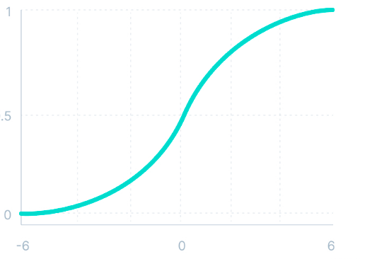
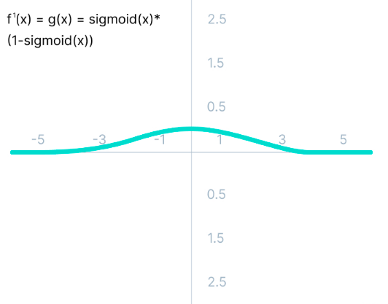
1) Sigmoid / Logistic Activation Function
Mathematically it can be represented as:
f(x)=1/(1+e^-x)
The derivative of the function is
f'(x) = sigmoid(x)*(1-sigmoid(x))

Slide 19
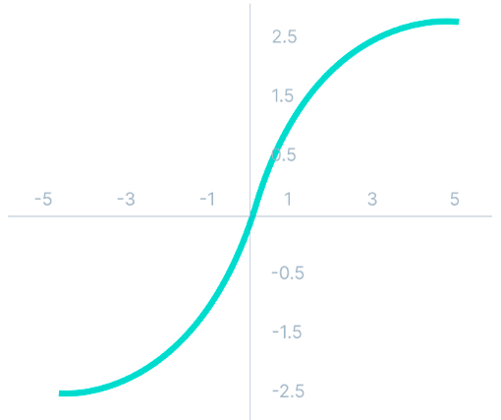
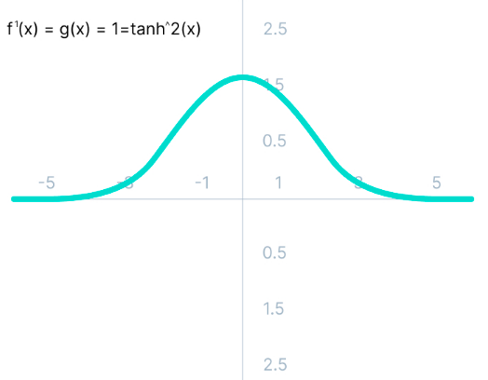
2)Tanh Function (Hyperbolic Tangent):
Mathematically it can be represented as: f(x)=(e^x-e^-x)/(e^x+e^-x)
Derivative of tanh(x) mathematically it can be represented as: f’(x)=1-(tanh(x))^2

Slide 20
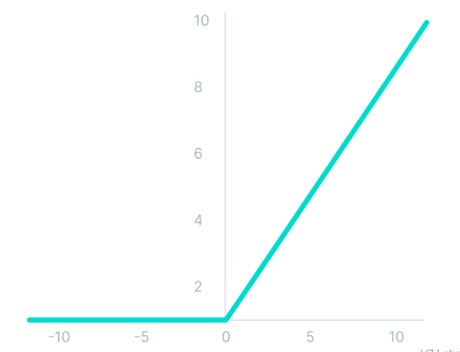
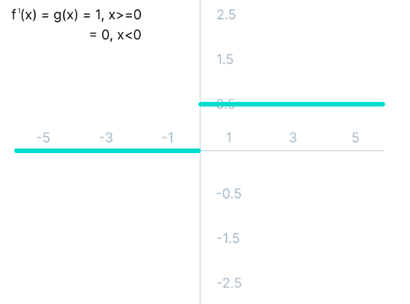
Mathematically it can be represented as: f(x)=max(0,x)
3)ReLU Function:
The derivative of the function is f'(x) = 1, x>=0
0, x<0

Slide 21
Over-fitting problem with Neural network:
Over-fitting is a concept in data science, which occurs when a statistical model fits exactly against its training data. When this happens, the algorithm unfortunately cannot perform accurately against unseen data, defeating its purpose. Generalization of a model to new data is ultimately what allows us to use machine learning algorithms every day to make predictions and classify data.
When machine learning algorithms are constructed, they leverage a sample dataset to train the model. However, when the model trains for too long on sample data or when the model is too complex, it can start to learn the “noise,” or irrelevant information, within the dataset. When the model memorizes the noise and fits too closely to the training set, the model becomes “over-fitted,” and it is unable to generalize well to new data. If a model cannot generalize well to new data, then it will not be able to perform the classification or prediction tasks that it was intended for.

Slide 22
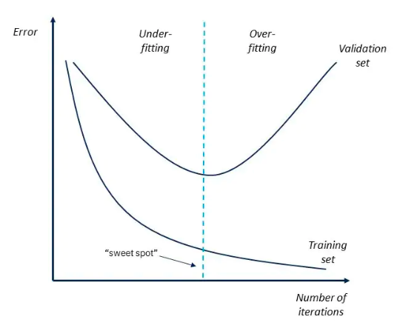
Figure 10: Describing Over-fitting
As shown in figure 10, when model give less error on train data and large error
for validation set, it start performing poor for unseen dataset (test dataset).

Slide 23
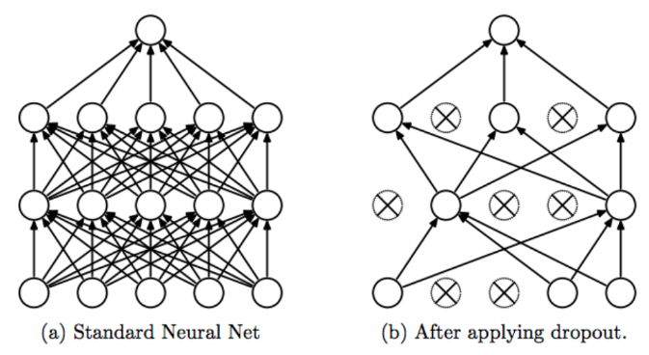
Dropout Layer
Figure 11: a): A standard neural net with 2 hidden layers. b):An example of a thinned net produced by applying dropout to the network on the left.Crossed units have been dropped.

Slide 24
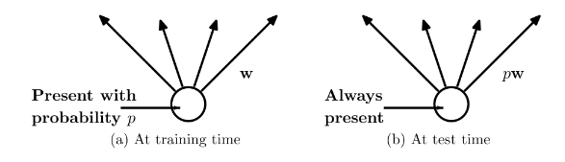
Figure 12: a): A unit at training time that is present with probability p and is connected to unitsin the next layer with weights w. b): At test time, the unit is always present and
the weights are multiplied by p. The output at test time is same as the expected output
at training time.

Slide 25
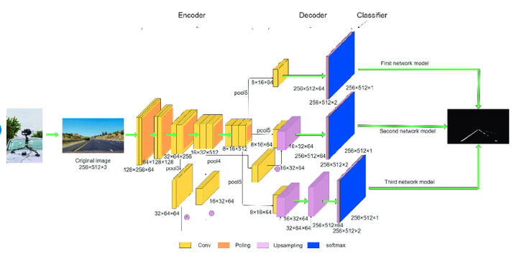
CNN model for lane detection

Slide 26
Problems with existing Lane detection CNN models:
Model with good accuracy are having high inference time which make it really hard for real time application.
Detecting lane during night is yet to be explore.
Detecting all the lane in the image is a difficult task.

